Slide 1
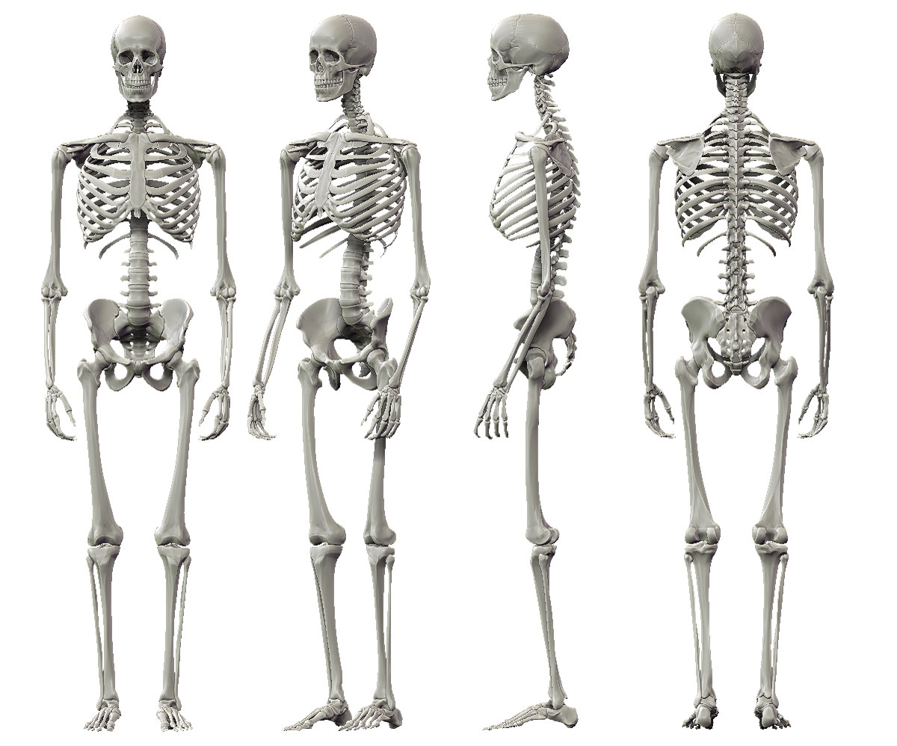
VERTEX
VERTEX
VERTEX
C7
C7
C7
RSHOULDER
LSHOULDER
LSHOULDER
LSHOULDER
RSHOULDER
RELBOW
LELBOW
LELBOW
LELBOW
RELBOW
RHIP
LHIP
LHIP
LHIP
RHIP
RWRIST
LWRIST
LWRIST
LWRIST
RWRIST
LFINGER
LFINGER
RFINGER
RFINGER
LFINGER
RKNEE
LKNEE
LKNEE
LKNEE
RKNEE
RANKLE
LANKLE
LANKLE
LANKLE
RANKLE
RHEEL*
LHEEL*
LTOE*
RTOE*
LHEEL
LHEEL
RHEEL
RTOE
LTOE
LTOE

